Slide 1
Extend ID3 decision tree algorithm using PCA
Amirkhosro Vosughi
CptS 570 Project, Fall 2017

Slide 2
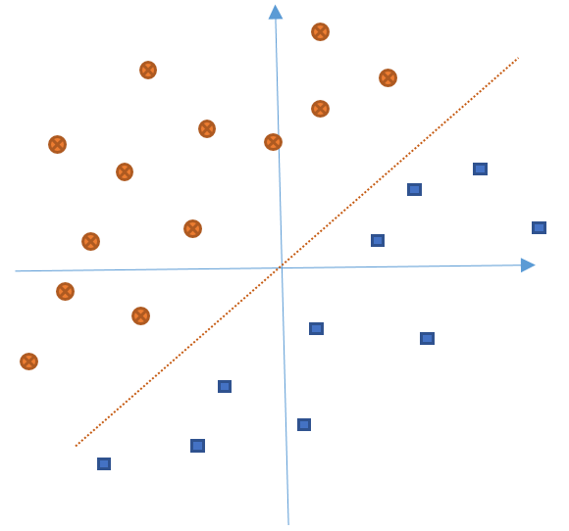
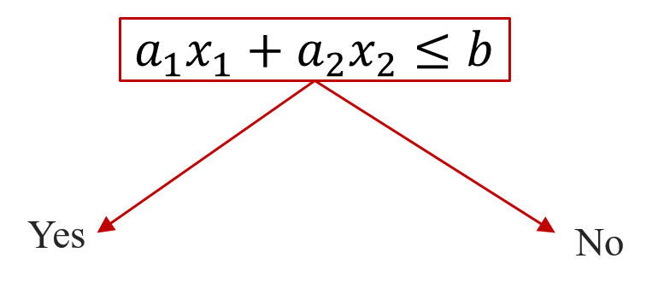
Motivation
Modify ID3 to have better performance in sense of depth
Assumption: For Binary classification with continuous features
Result presented for two continuous features for simplicity: Extendable to as many continuous features
Use linear combination of features in each node of ID3

Slide 3
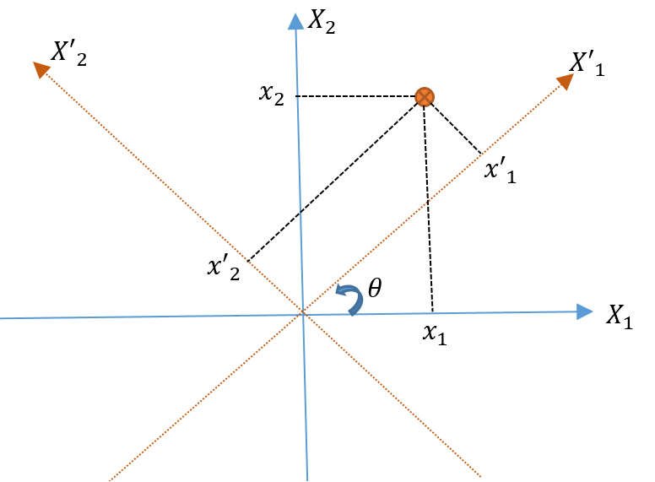
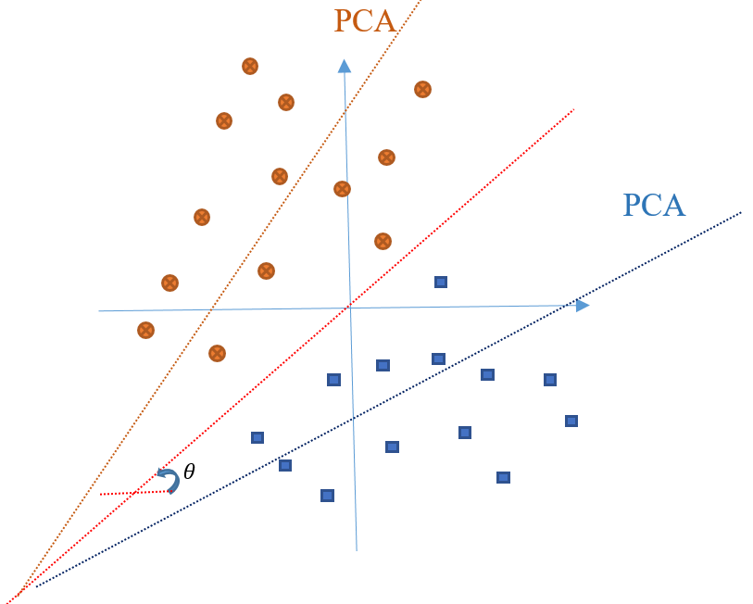
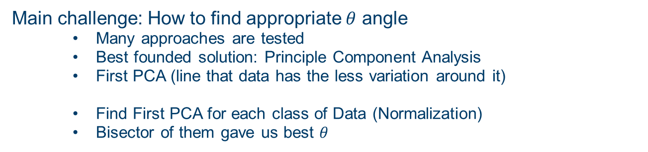

Solution
Disassemble the Problem:
Frist rotate the coordinate by appropriate $θ$ angle (gives $a_{1} \& a_{2}$)
Then use ordinary ID3 (to find $b$)
Main challenge: How to find appropriate $θ$ angle
Many approaches are tested
Best founded solution: Principle Component Analysis
First PCA (line that data has the less variation around it)
Find First PCA for each class of Data (Normalization)
Bisector of them gave us best $θ$

Slide 4
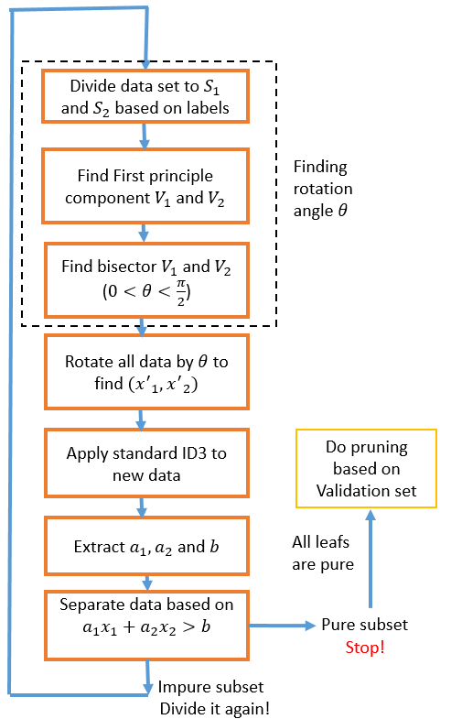
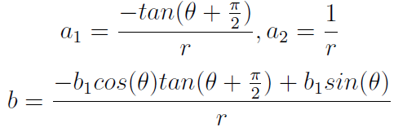
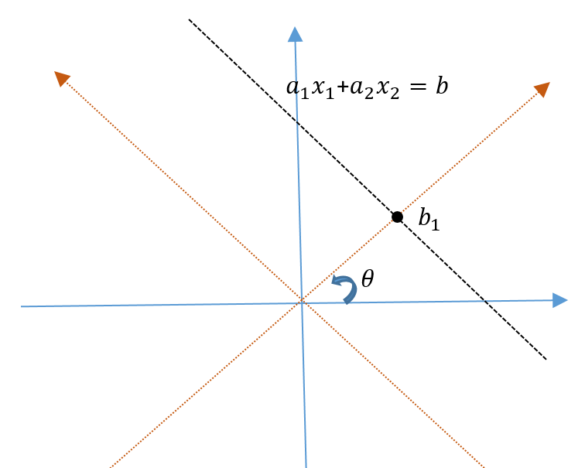
Overview

Slide 5
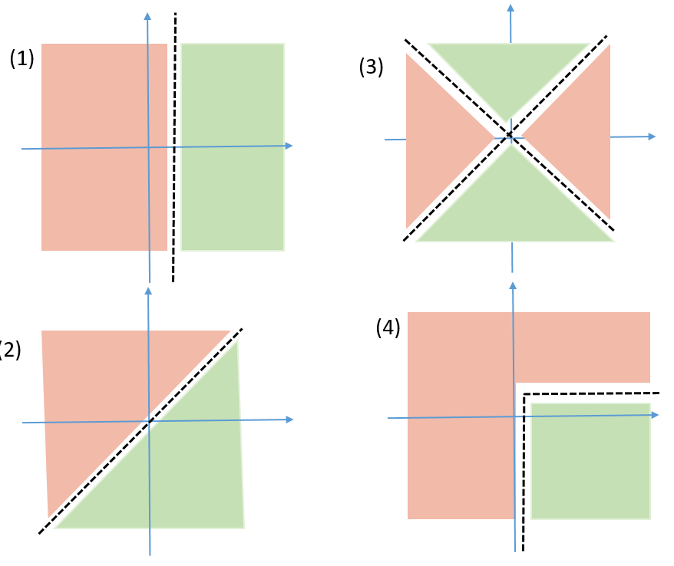
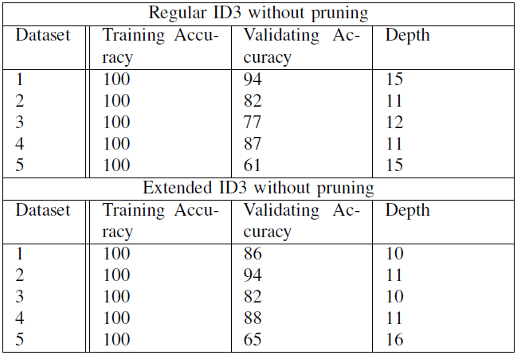
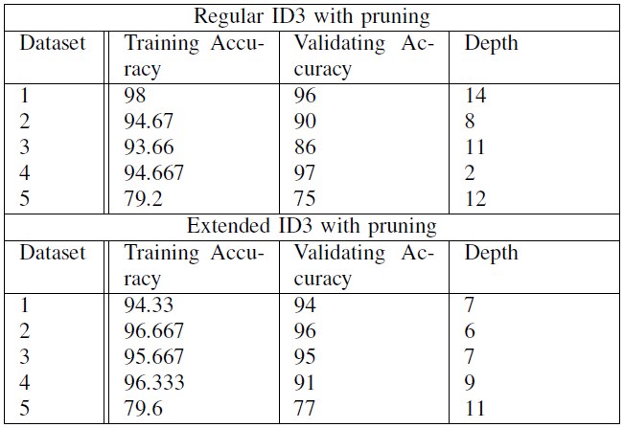
Results
(5) Dataset:
UCI Machine Learning Repository
Blood Transfusion Service Center
Binary output → does person donate blood this month
2 continuous features → 1. months from first donation, 2. total # donation

Slide 6
Question
Thank You

